Slide 1
Azure Networking
Ajay Choudhary

Slide 2
Key Capabilities of Networking Services
Connectivity services: Connect Azure resources and on-premises resources using any or a combination of these networking services in Azure - Virtual Network (VNet), Virtual WAN, ExpressRoute, VPN Gateway, Virtual network NAT Gateway, Azure DNS, Peering service, and Azure Bastion.
Application protection services: Protect your applications using any or a combination of these networking services in Azure - Load Balancer, Private Link, DDoS protection, Firewall, Network Security Groups, Web Application Firewall, and Virtual Network Endpoints.
Application delivery services: Deliver applications in the Azure network using any or a combination of these networking services in Azure - Content Delivery Network (CDN), Azure Front Door Service, Traffic Manager, Application Gateway, Internet Analyzer, and Load Balancer.
Network monitoring: Monitor your network resources using any or a combination of these networking services in Azure - Network Watcher, ExpressRoute Monitor, Azure Monitor, or VNet Terminal Access Point (TAP).

Slide 3
Connectivity services
Virtual network - Azure Virtual Network (VNet) is the fundamental building block for your private network in Azure. You can use VNets to:
Communicate between Azure resources: You can deploy VMs, and several other types of Azure resources to a virtual network, such as Azure App Service Environments, the Azure Kubernetes Service (AKS), and Azure Virtual Machine Scale Sets.
Communicate between each other: You can connect virtual networks to each other, enabling resources in either virtual network to communicate with each other, using virtual network peering. The virtual networks you connect can be in the same, or different, Azure regions.
Communicate to the internet: All resources in a VNet can communicate outbound to the internet, by default. You can communicate inbound to a resource by assigning a public IP address or a public Load Balancer. You can also use Public IP addresses or public Load Balancer to manage your outbound connections.
Communicate with on-premises networks: You can connect your on-premises computers and networks to a virtual network using VPN Gateway or ExpressRoute.

Slide 4
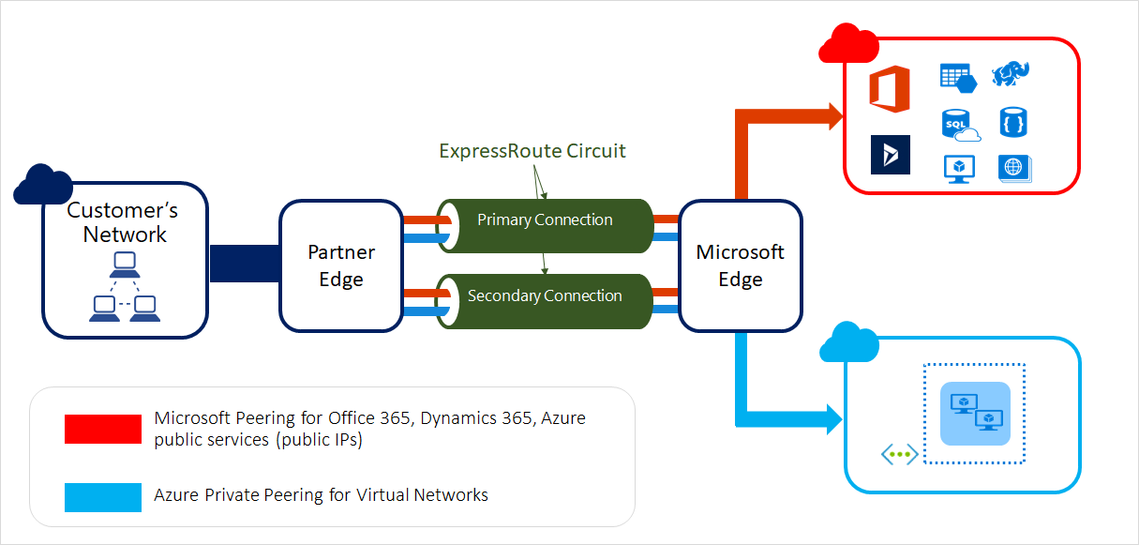
ExpressRoute
ExpressRoute enables you to extend your on-premises networks into the Microsoft cloud over a private connection facilitated by a connectivity provider. This connection is private. Traffic does not go over the internet. With ExpressRoute, you can establish connections to Microsoft cloud services, such as Microsoft Azure, Microsoft 365, and Dynamics 365.

Slide 5
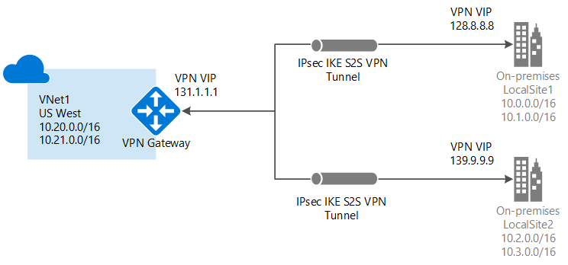
VPN Gateway
VPN Gateway helps you create encrypted cross-premises connections to your virtual network from on-premises locations, or create encrypted connections between VNets. There are different configurations available for VPN Gateway connections. Some of the main features include:
Site-to-site VPN connectivity
Point-to-site VPN connectivity
VNet-to-VNet VPN connectivity

Slide 6
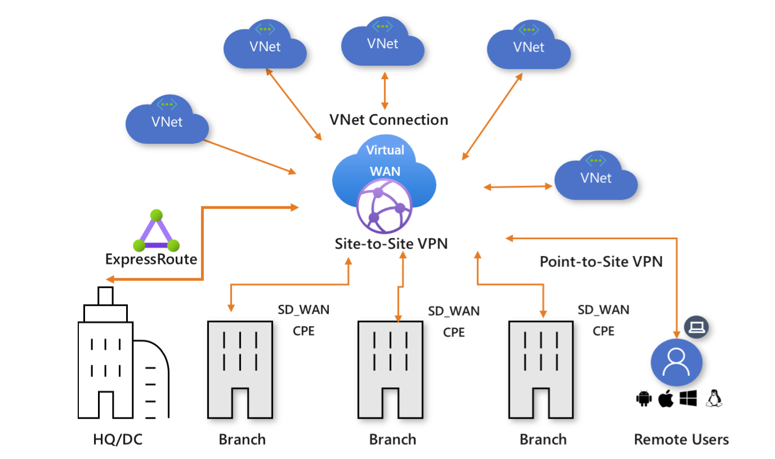
Virtual WAN
Azure Virtual WAN is a networking service that brings many networking, security, and routing functionalities together to provide a single operational interface. Connectivity to Azure VNets is established by using virtual network connections. Some of the main features include:
Branch connectivity (via connectivity automation from Virtual WAN Partner devices such as SD-WAN or VPN CPE)
Site-to-site VPN connectivity
Remote user VPN connectivity (point-to-site)
Private connectivity (ExpressRoute)
Intra-cloud connectivity (transitive connectivity for virtual networks)
VPN ExpressRoute inter-connectivity
Routing, Azure Firewall, and encryption for private connectivity

Slide 7
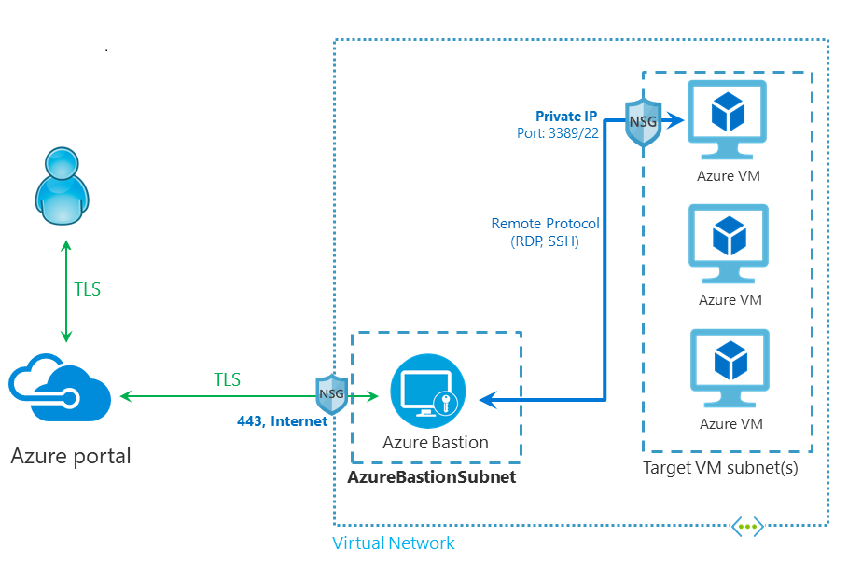
Azure DNS
Azure DNS is a hosting service for DNS domains that provides name resolution by using Microsoft Azure infrastructure. By hosting your domains in Azure, you can manage your DNS records by using the same credentials, APIs, tools, and billing as your other Azure services.
Azure Bastion
Azure Bastion is service you can deploy that lets you connect to a virtual machine using your browser and the Azure portal, or via the native SSH or RDP client already installed on your local computer. The Azure Bastion service is a fully platform-managed PaaS service that you provision inside your virtual network. It provides secure and seamless RDP/SSH connectivity to your virtual machines directly from the Azure portal over TLS. When you connect via Azure Bastion, your virtual machines don't need a public IP address, agent, or special client software.

Slide 8
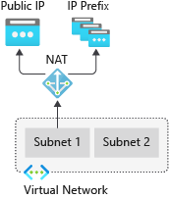
Azure Peering Service
Azure Peering service enhances customer connectivity to Microsoft cloud services such as Microsoft 365, Dynamics 365, software as a service (SaaS) services, Azure, or any Microsoft services accessible via the public internet.
Virtual network NAT Gateway
Virtual Network NAT (network address translation) simplifies outbound-only Internet connectivity for virtual networks. When configured on a subnet, all outbound connectivity uses your specified static public IP addresses. Outbound connectivity is possible without load balancer or public IP addresses directly attached to virtual machines.

Slide 9
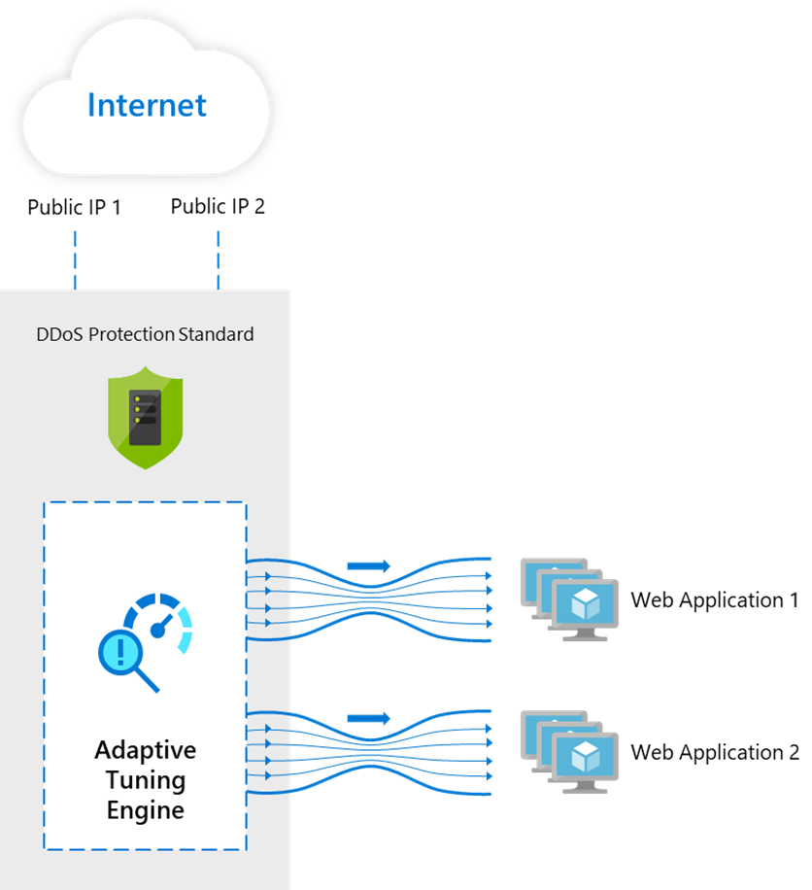
Application protection services
This section describes networking services in Azure that help protect your network resources - Protect your applications using any or a combination of these networking services in Azure - DDoS protection, Private Link, Firewall, Web Application Firewall, Network Security Groups, and Virtual Network Service Endpoints.
DDoS Protection - provides countermeasures against the most sophisticated DDoS threats. The service provides enhanced DDoS mitigation capabilities for your application and resources deployed in your virtual networks. Additionally, customers using Azure DDoS Protection have access to DDoS Rapid Response support to engage DDoS experts during an active attack.

Slide 10
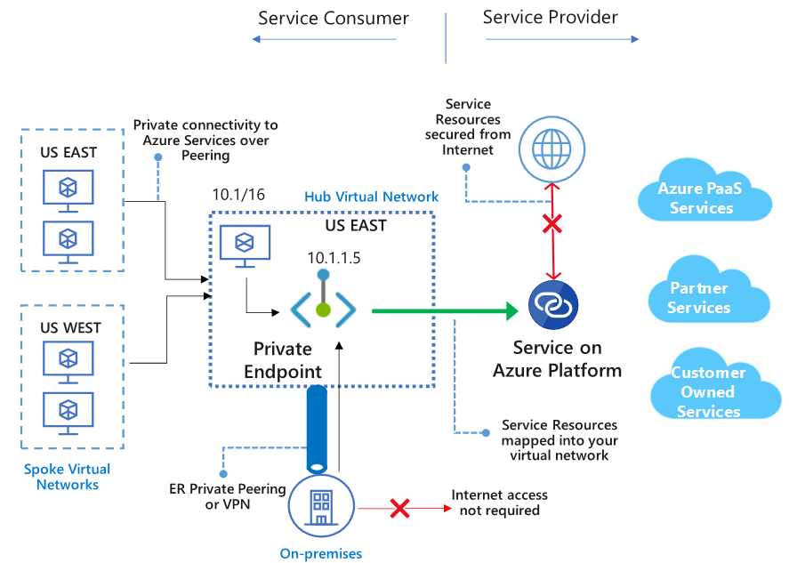
Azure Private Link - enables you to access Azure PaaS Services (for example, Azure Storage and SQL Database) and Azure hosted customer-owned/partner services over a private endpoint in your virtual network. Traffic between your virtual network and the service travels through the Microsoft backbone network. Exposing your service to the public internet is no longer necessary. You can create your own private link service in your virtual network and deliver it to your customers.

Slide 11
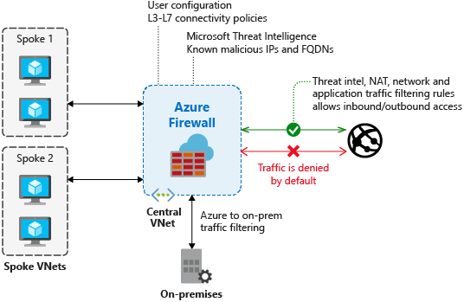
Azure Firewall
Azure Firewall is a managed, cloud-based network security service that protects your Azure Virtual Network resources. Using Azure Firewall, you can centrally create, enforce, and log application and network connectivity policies across subscriptions and virtual networks. Azure Firewall uses a static public IP address for your virtual network resources allowing outside firewalls to identify traffic originating from your virtual network.

Slide 12
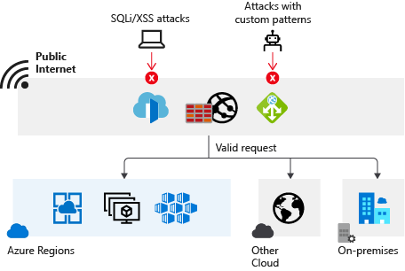
Web Application Firewall - (WAF) provides protection to your web applications from common web exploits and vulnerabilities such as SQL injection, and cross site scripting. Azure WAF provides out of box protection from OWASP top 10 vulnerabilities via managed rules. Additionally customers can also configure custom rules, which are customer managed rules to provide additional protection based on source IP range, and request attributes such as headers, cookies, form data fields or query string parameters.
Network security groups
You can filter network traffic to and from Azure resources in an Azure virtual network with a network security group.

Slide 13
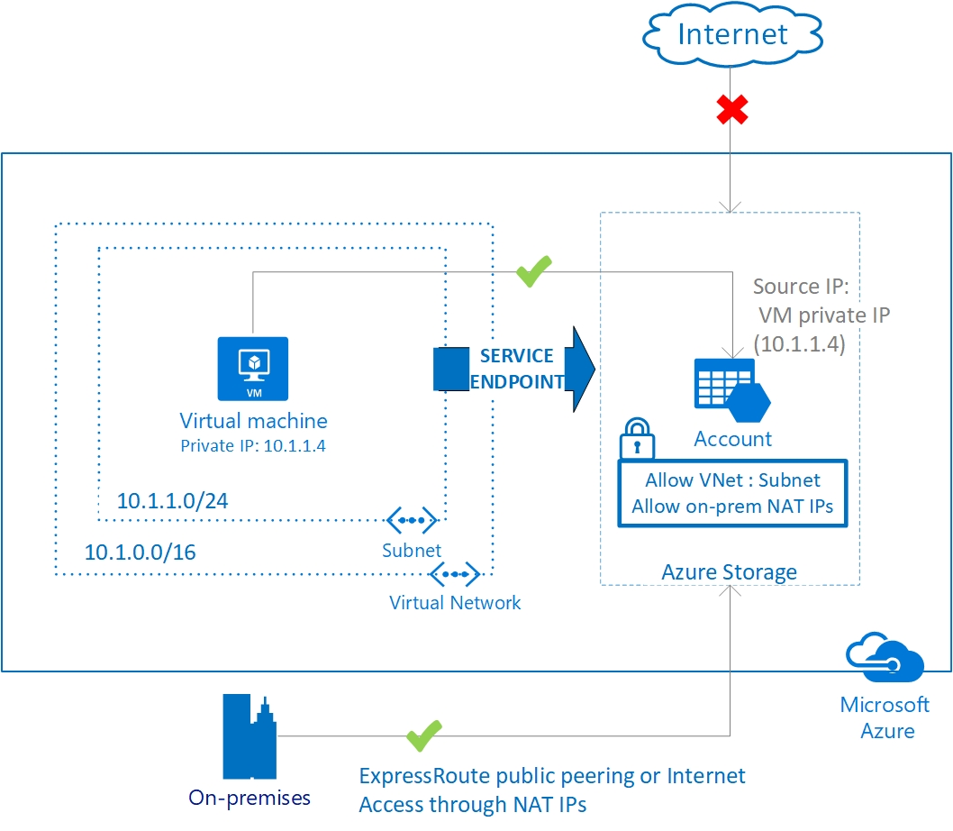
Service endpoints
Virtual Network (VNet) service endpoints extend your virtual network private address space and the identity of your VNet to the Azure services, over a direct connection. Endpoints allow you to secure your critical Azure service resources to only your virtual networks. Traffic from your VNet to the Azure service always remains on the Microsoft Azure backbone network.

Slide 14
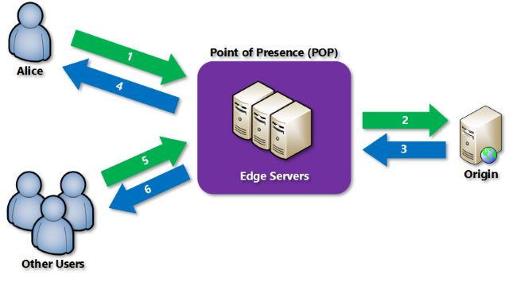
Application delivery services
This section describes networking services in Azure that help deliver applications - Content Delivery Network, Azure Front Door Service, Traffic Manager, Load Balancer, and Application Gateway.
Content Delivery Network
Azure Content Delivery Network (CDN) offers developers a global solution for rapidly delivering high-bandwidth content to users by caching their content at strategically placed physical nodes across the world.

Slide 15
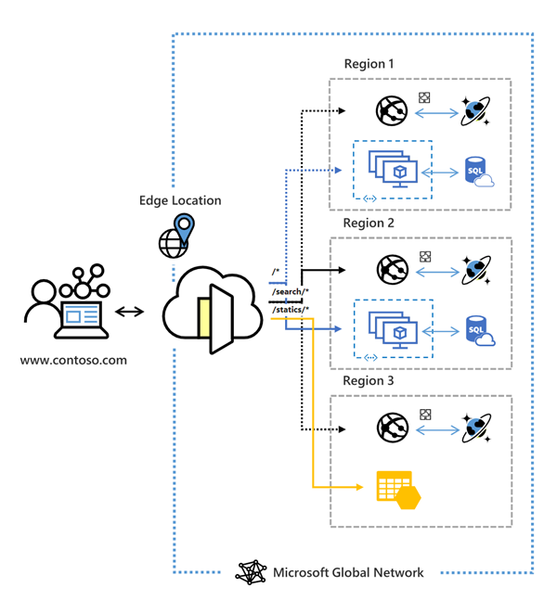
Azure Front Door Service
Azure Front Door Service enables you to define, manage, and monitor the global routing for your web traffic by optimizing for best performance and instant global failover for high availability. With Front Door, you can transform your global (multi-region) consumer and enterprise applications into robust, high-performance personalized modern applications, APIs, and content that reach a global audience with Azure.

Slide 16
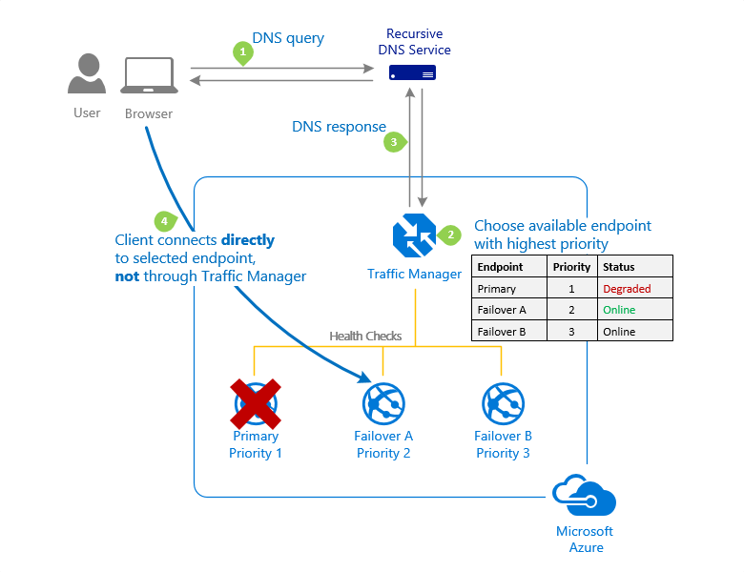
Traffic Manager
Azure Traffic Manager is a DNS-based traffic load balancer that enables you to distribute traffic optimally to services across global Azure regions, while providing high availability and responsiveness. Traffic Manager provides a range of traffic-routing methods to distribute traffic such as priority, weighted, performance, geographic, multi-value, or subnet.

Slide 17
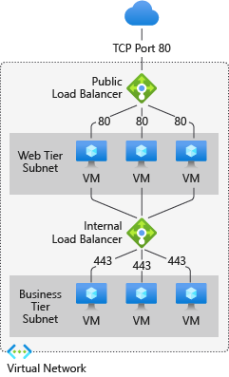
Load Balancer
The Azure Load Balancer provides high-performance, low-latency Layer 4 load-balancing for all UDP and TCP protocols. It manages inbound and outbound connections. You can configure public and internal load-balanced endpoints. You can define rules to map inbound connections to back-end pool destinations by using TCP and HTTP health-probing options to manage service availability.

Slide 18
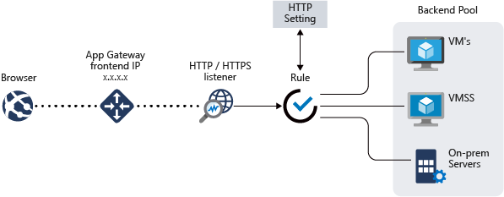
Application Gateway
Azure Application Gateway is a web traffic load balancer that enables you to manage traffic to your web applications. It is an Application Delivery Controller (ADC) as a service, offering various layer 7 load-balancing capabilities for your applications.

Slide 19
Network monitoring services
This section describes networking services in Azure that help monitor your network resources - Network Watcher, Azure Monitor Network Insights, Azure Monitor, ExpressRoute Monitor, and Virtual Network TAP.
Network Watcher
Azure Network Watcher provides tools to monitor, diagnose, view metrics, and enable or disable logs for resources in an Azure virtual network.
Azure Monitor Network Insights
Azure Monitor for Networks provides a comprehensive view of health and metrics for all deployed network resources, without requiring any configuration. It also provides access to network monitoring capabilities like Connection Monitor, flow logging for network security groups, and Traffic Analytics.
Azure Monitor
Azure Monitor maximizes the availability and performance of your applications by delivering a comprehensive solution for collecting, analyzing, and acting on telemetry from your cloud and on-premises environments. It helps you understand how your applications are performing and proactively identifies issues affecting them and the resources they depend on.

Slide 20
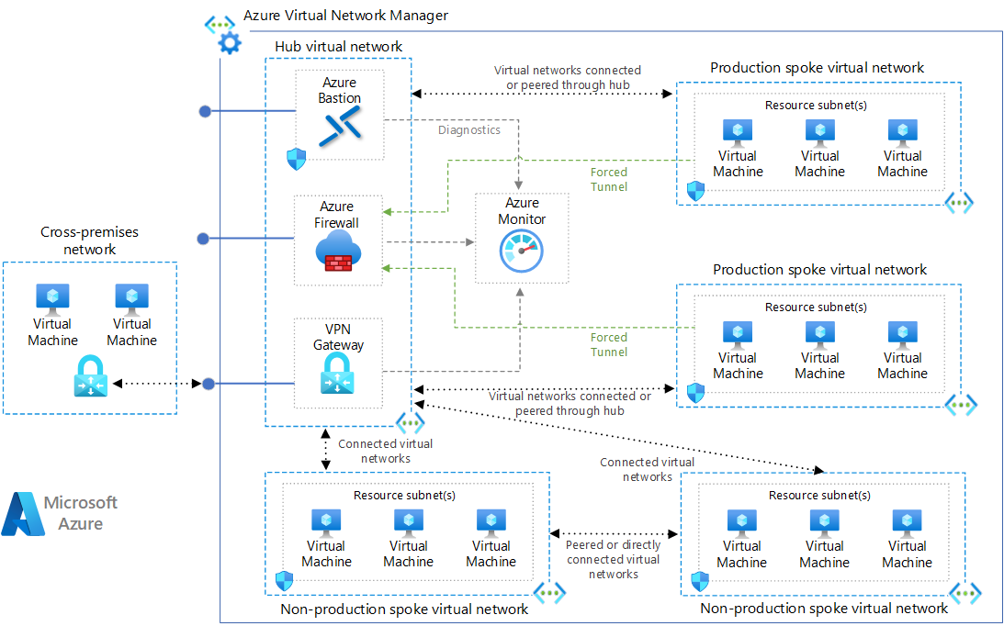
Hub-spoke network topology in Azure

Slide 21
This reference architecture implements a hub-spoke network pattern with customer-managed hub infrastructure components. Click here
For documentation
For Code
For basic deployment, open Azure CLI from Azure portal which opens in the bottom section of Azure portal. Execute below code to deployment
az group create --name hub-spoke --location eastus
az deployment group create --resource-group hub-spoke --template-uri https://raw.githubusercontent.com/mspnp/samples/main/solutions/azure-hub-spoke/azuredeploy.json

Slide 22
Demo Hub-spoke network topology in Azure

Slide 23
Thank you
Ajay Choudhary
ajay.choudhary@zensar.com
Microsoft Certification's Completed

